Slide 1
AI/ML Project
Submitted by : Bisman Dhillon(2210990230)
Submitted to:
Chitkara University Institute of Engineering and Technology, Chitkara University, Punjab

Slide 2
Table of Contents
Problem Statement
Technical Details
Key Features
Conclusion
References/Links used

Slide 3
Problem Statement
The objective is to create an interactive game where two players can take turns marking spaces in a 3x3 grid . The goal is to create an efficient and enjoyable implementation of the classic Tic Tac Toe game using Python programming language.

Slide 4


Technical Details
Programming Language : Python
Development Environment : Visual Studio Code

Slide 5
Key Features
Simple Interface : A clean and user-friendly design for easy navigation and operation.
Game Board Representation: Implement a 3x3 grid to represent the Tic Tac Toe board.
Memory Function : Ability to store and recall previous results.
Turn-Based Gameplay: Implement turn-based gameplay where two players take turns marking spaces on the board .
Winning Condition Detection: Detect when a player has achieved a winning combination of symbols.

Slide 6
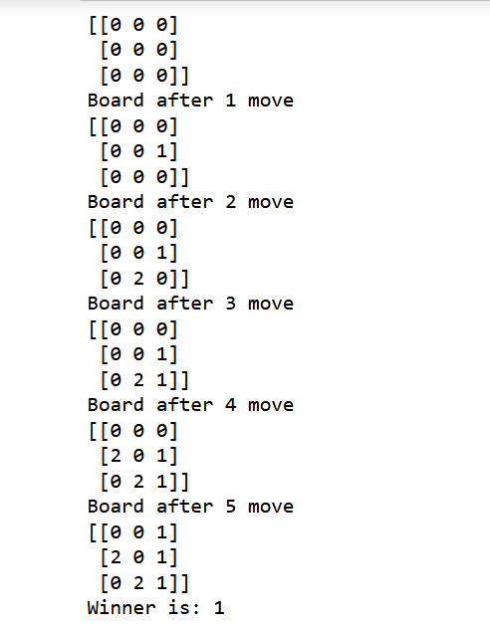
Game Interface

Slide 7
Conclusion
The implementation of a Tic Tac Toe game in Python offers a comprehensive exploration of fundamental programming concepts while providing an entertaining and interactive gaming experience. The Tic Tac Toe project serves as an excellent learning opportunity for aspiring programmers to sharpen their skills

Slide 8
References/Links used
Python Installer : https://www.python.org/downloads/

Slide 9


